Slide 1
Crime Data for New York City
Benjamin Grossmann

Slide 2
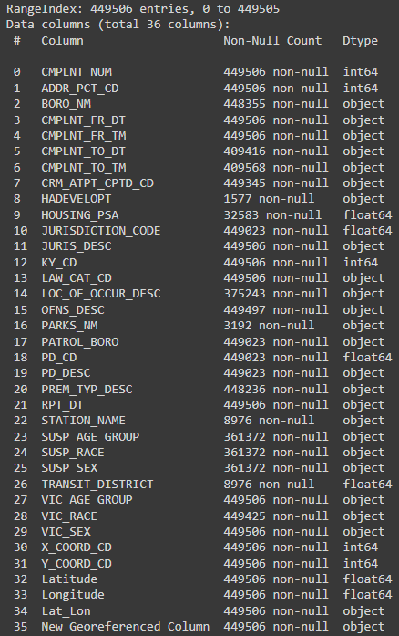
About the Data Set
Data Set Being Used: NYPD Complaint Data Current (Year To Date) (NYC OpenData https://opendata.cityofnewyork.us/ )
Crimes reported to the NYPD
Updated Quarterly
Data retrieved April 8, 2022
Data Set Description
36 features
25 string types
Standardized before being made public
11 numeric types
Some irregularities
449,506 rows (each a unique report)

Slide 3
About the Data Set
Column Information
Report Identifier (1 column)
Location Information (17 columns)
Times and Dates (5 columns)
Special Codes (7 columns)
Suspect and Victim Demographics (6 columns)
Analysis Target: Offense Severity (‘LAW_CAT_COD’)
Three levels: Violation, Misdemeanor, Felony
Analysis Question: What is the level of a crime for a given type of location?

Slide 4
Data Selection
Scope of Data Selection
Identify data at the Precinct level 77 Precincts in NYC This is the level that police departments generally interact with at the local level
Unique Identifier Set as Index
Keep newly created duplicates 1576 duplicates (0.35% of all rows) (multiple suspects with matching descriptions)
Rows by Year
Keep year 2021 439,625 rows (97.8% of all rows)
Drop years prior to 2021 9,881 rows (2.2% of all rows)

Slide 5
Data Selection
Columns with Location Information
Keep Precinct Identifier Column
Keep Premise Type (ex: Residence, Bank, Bridge)
Drop other location information
They are either too General, too Specific, or Redundant
Columns with Times and Dates
Keep Date and Time Offense Begins
Drop Date and Time Offense Ends [Null Values Present]
Drop Date Report is made
Columns with Special Codes
Drop Offense Description
Drop Columns Adding Details to Other Columns
Drop Columns that Assign Numerical Value to Categorical Column Values
Columns with Suspect and Victim Demographics
Drop Suspect and Victim [Null Values Present]
Likely entangled with population demographics of precincts

Slide 6
Date Values: Strings to Numbers
Errors when attempting datetime conversion
Tracked down to years 1019, 1021
Dropped all years before 2021
Dates in format “mm/dd/yyyy”
Used slice on Date string filter_2021 = df["CMPLNT_FR_DT"].apply(lambda x: x[6:])=="2021" df = df.loc[filter_2021, :]
Converted with pd.to_datetime()
Values didn’t play nice in some graphs (especially correlation heatmap)
Solution: Converted to integer day of year (1 through 365) df["CMPLNT_FR_DT"] = pd.to_datetime(df["CMPLNT_FR_DT"]) df["CMPLNT_FR_DT"] = df["CMPLNT_FR_DT"].apply(lambda x: x.timetuple().tm_yday)

Slide 7
Time Values: Strings to Numbers
Datetime conversion always added year and day to time
When year remove, data type didn’t work in graphs and calculations
Times were to the minute
Graphing time of day was not pleasant visually (Histogram with 1,440 bars for one offense level)
Solution: Binned time into 15 minute intervals, and convert to decimal fraction of hour
Times in format “hh:mm:ss”
Use slice on Time string df["CMPLNT_FR_TM"] = df["CMPLNT_FR_TM"].apply(lambda x: int(x[:2]) + np.floor(int(x[3:5]) * 1 / 60 * 4 ) * 0.25)

Slide 8
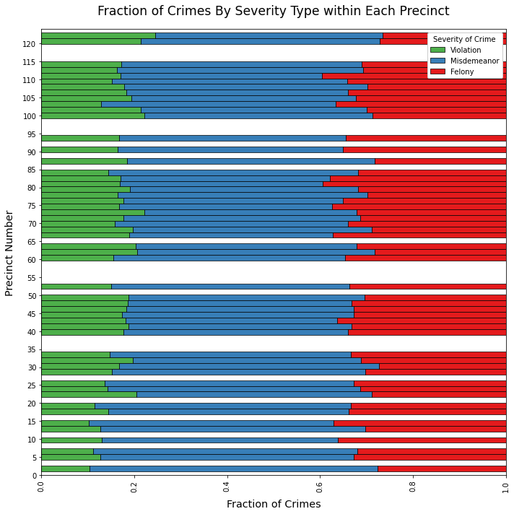
Precincts have Similar Ratios of Crime Severities
≈ 15% Violations
≈ 30% Felonies
≈ 55% Misdemeanors
This would indicate that the division of resources and crime prevention measures might be distributed similarly among precincts.

Slide 9
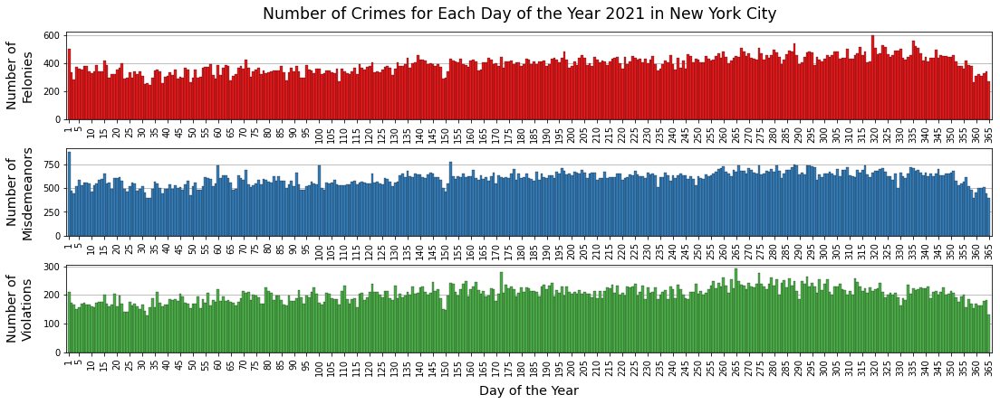
Crime Rates Rose Throughout 2021

Slide 10
Crime Rates Rose Throughout 2021
This indicates that the time of year is potentially important for determining when crime prevention efforts should be increased.
There is a big caveat, however. The year 2021 was a pandemic year, so the yearly trend in crime may not be typical.
A follow-up project should examine other years to make a determination.

Slide 11
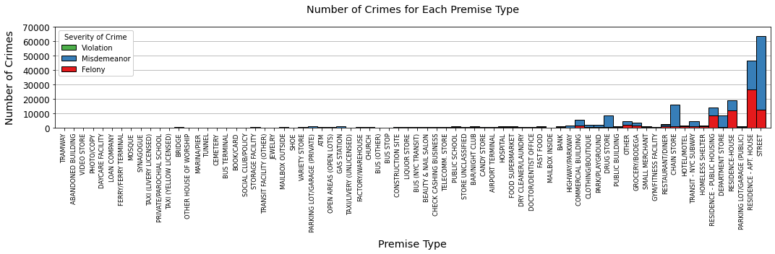
Majority of crimes either in streets or residences
These very different types of settings would require very different approaches, as one type is a very public location and the other type is a very private location. How these are distributed throughout the city may entail different solutions within different precincts.

Slide 12
Thank you

